Slide 1
AIR Terrorism Loss Estimation Model
Jack Seaquist
Terrorism Model Product Manager
AIR Worldwide, Inc.

Slide 2
Topics
AIR Background
AIR Terrorism Loss Analysis Model
Use of Model Output for Underwriting and Pricing
Impact on Terrorism Risk Insurance

Slide 3
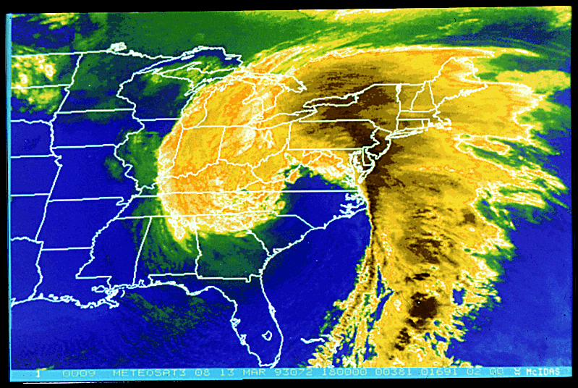
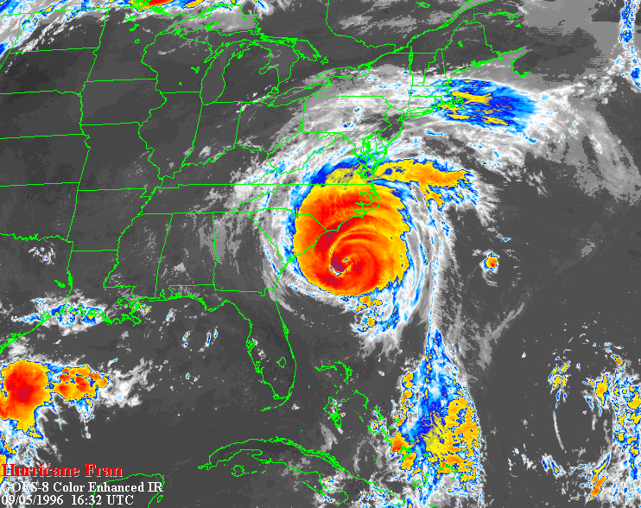
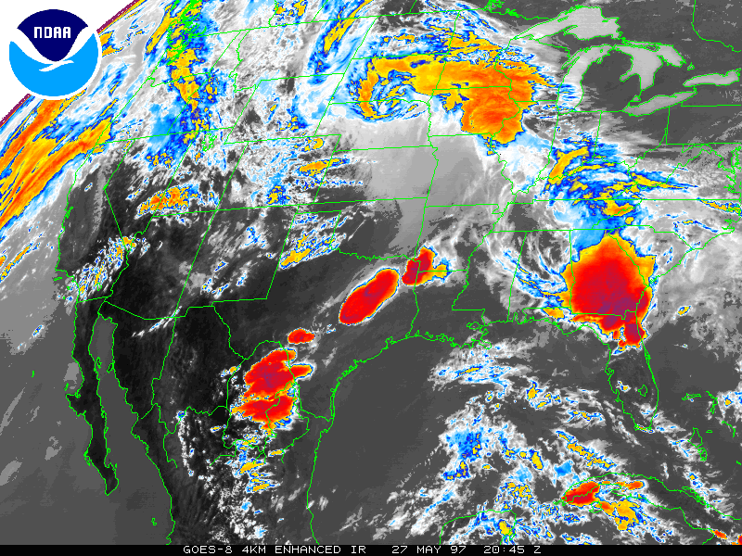
AIR Models Losses Due to Extreme Winds ...
Extratropical
(Winterstorms)
Tropical
(Hurricanes)
Severe
Thunderstorm
(Tornado)

Slide 4
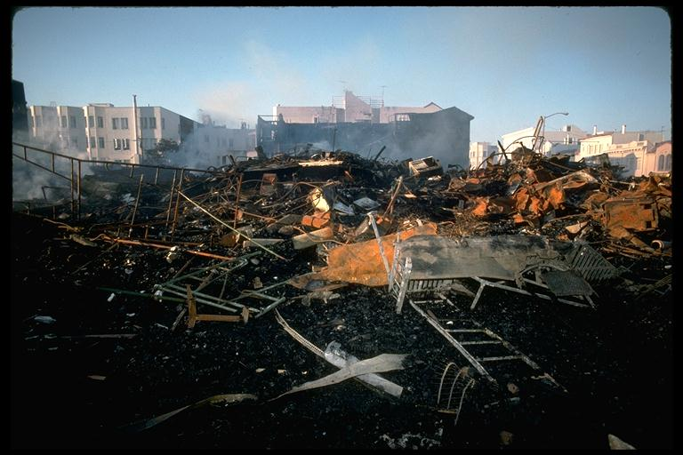
... Earthquakes

Slide 5

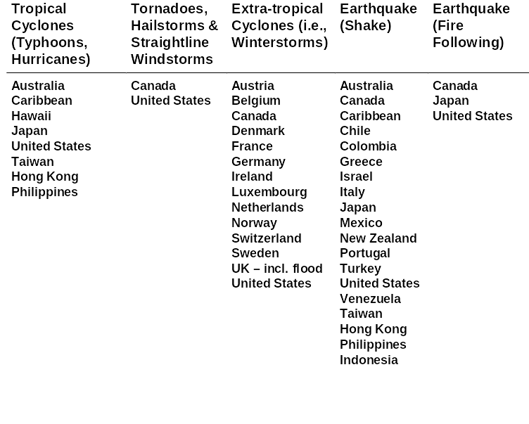
… and Other Perils Throughout the World

Slide 6
Introduction: AIR Technical Staff
Seismologists
Software
Specialists
Engineers
Mathematicians and Statisticians
Reinsurance and Insurance Specialists
Over 100 professionals
Multi-discipline approach
Over thirty hold PhD’s
Operations Researchers
Meteorologists
Actuaries
Physicists
Geophysicists

Slide 7

Models, Perils, and Lines of Business

Slide 8
Components of Catastrophe Models - Terrorism Challenges
Hazard
Engineering
Loss Estimation
Event
Generation
Intensity
Calculation
Damage
Calculation
Exposure
Information
Insured Loss
Calculation
Validation,
Reporting
Policy
Conditions
Where might future terrorist attacks occur?
For each possible attack, how much loss could be expected?
How often and how big?

Slide 9
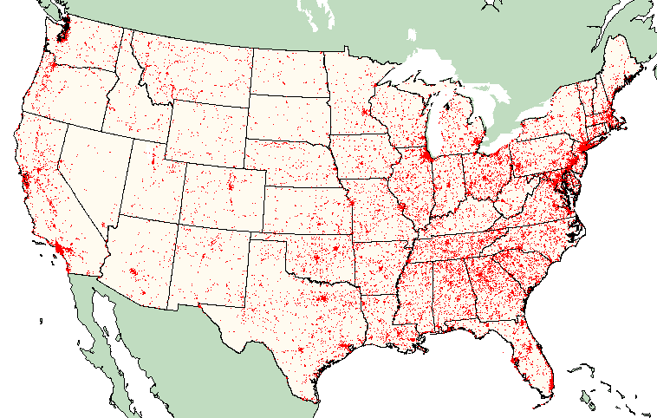
AIR Models Possible Conventional Attacks Where They are Likely to Occur - AIR Landmark Database
Commercial facilities
  Prominent buildings
  Corporate headquarters
  Transportation facilities and
  critical infrastructure
  Industrial facilities
  Energy facilities
  Retail centers and malls
  Sport arenas and stadiums
  Amusement parks
Government facilities
  Federal office buildings
  and courthouses
  Embassies
  Postal facilities
Educational, medical, and religious institutions
Over 300,000 Landmarks

Slide 10
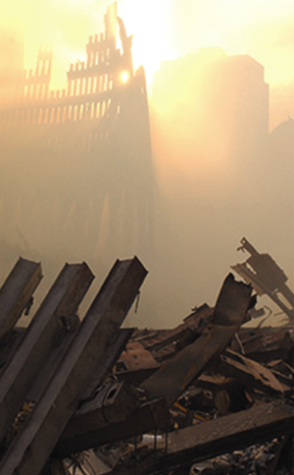
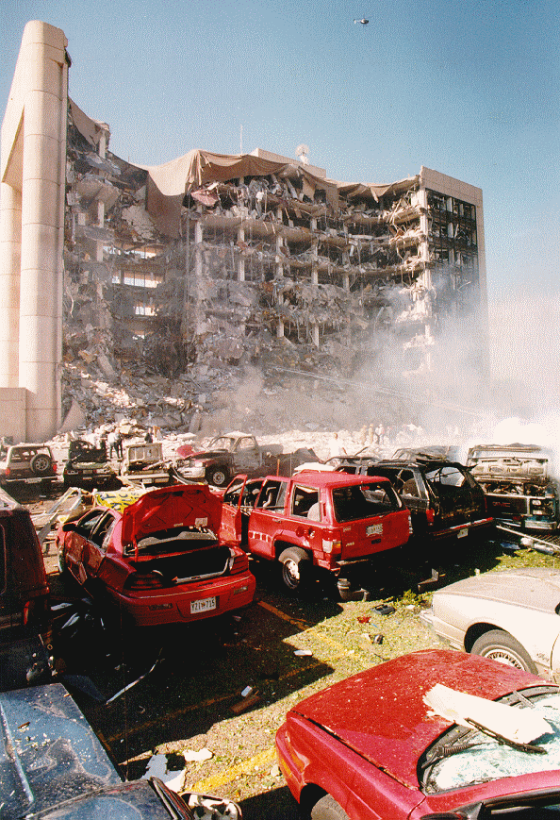
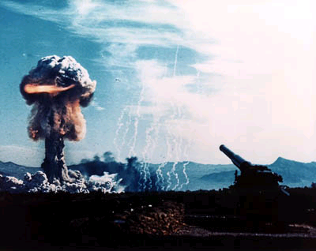
Weapon Intensity and Resulting Damage
Bomb Blast
Air Crash
Chemical
Biological
Radiological
Nuclear

Slide 11
Components of AIR’s Conventional Injury Model
Earthquake
Events
Engineering
Loss
Estimation
Damage
state
Damage
state
Damage
state
Damage
state
Damage
state
Building
Information
Damage
state
Damage
state
Damage
ratio
distribution
Damage
state
Injury
Severity
Levels
Loss
Calculation
Terrorism
Events
Number of
Employees
Cost of
injuries

Slide 12

Modeling CBRN using Consequences Assessment Tool Set (CATS)
Developed by Defense Threat Reduction Agency (DTRA)
  Responsibility in Defense Department for all aspects of weapons of mass destruction
  Includes former Defense Nuclear Agency
  Built upon more than 50 years of research
  Includes Hazard Prediction and Assessment Capability (HPAC)
Resulted from demands of Operation Desert Storm
Used for emergency management, defensive planning, and operational planning

Slide 13
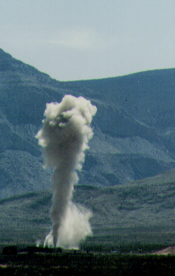
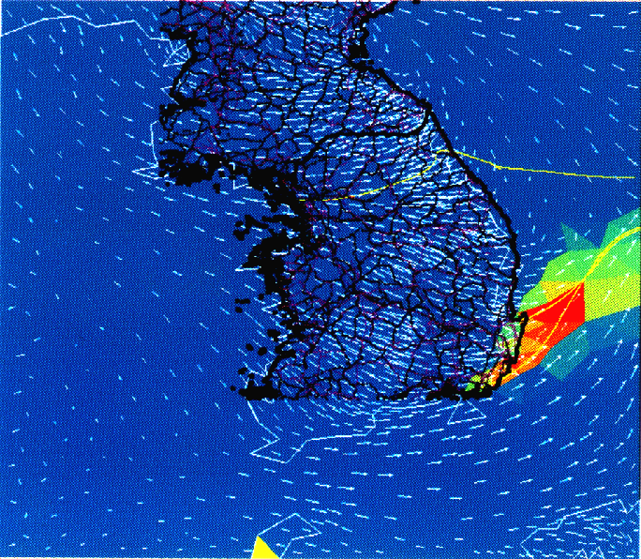
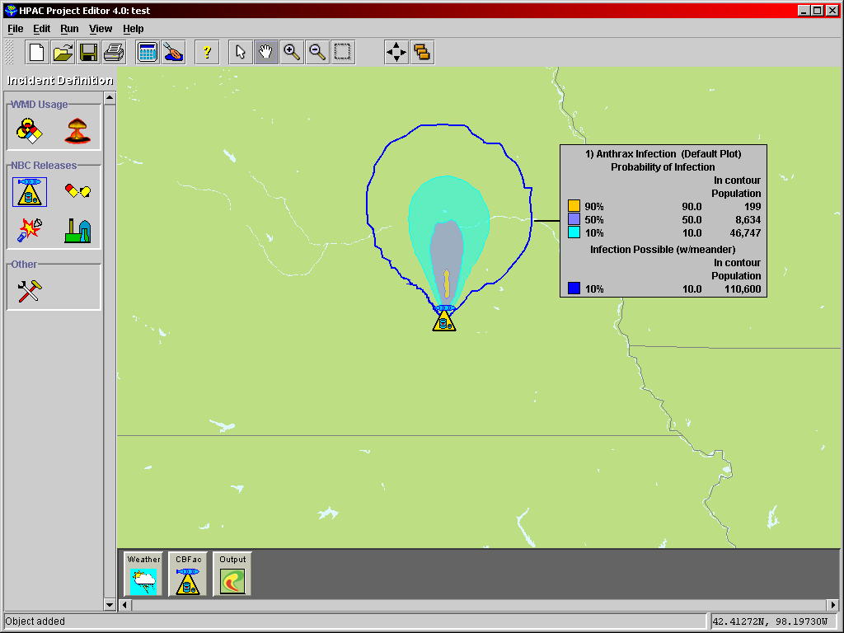
Components of HPAC
Hazard Sources
Weather & Transport
Effects
Chem/Bio Facilities
Chem/Bio Weapons
Nuclear Weapons
Nuclear Facilities
Nuclear Weapon Incident
Missile Intercept
Historical Weather
Forecast Weather
Current Observations
Forensic Weather
Particle Transport
Human Medical Effects
Toxicity Levels
Contaminated Areas
Population Exposure
Hazard Areas
Casualties

Slide 14
Military Applications of HPAC
Military Commander In Chiefs use for offensive and defensive planning
European Command, Pacific Command, Strategic Command and Central Command
HPAC has also been used to support the Bosnia deployment and Desert Thunder planning
Defense Intelligence Agency, Joint Chiefs of Staff, National Command Authority also use for assessment of potential WMD hazards
The Chemical and Biological Incident Response Force, the Directorate of Operations for Military Support for Domestic Preparedness, the Federal Bureau of Investigation, and the Center for Disease Control use for domestic support
The Gulf War Office used HPAC to evaluate the impact of destruction of chemical weapons after the Gulf War

Slide 15
Civilian Applications of HPAC
The 1996 Summer Olympics in Atlanta, Georgia
The 2002 Winter Olympics in Salt Lake City, Utah
The September 11th attacks on the World Trade Center and the Pentagon
The 1997 (53rd) & 2001 (54th) Presidential Inaugurations
The 2000 & 2001 State of the Union Addresses
The 1997 Group of Eight Summit in Denver, Colorado

Slide 16
How Often and How Big?
Expert opinion used for attack frequency/severity and allocation to landmarks
  Problem is partitioned into manageable pieces
  Delphi Method used to combine expert opinions
  Experts in counterterrorism operations and threat assessment
  Experience from FBI, CIA, Defense Dept., Energy Dept., etc.
Results in attack likelihood (frequency) for each individual landmark and event

Slide 17
Delphi Method Provides Sound Basis for Frequency Estimates
Developed during 1940s at the RAND Corporation to study the "broad subject of inter-continental warfare other than surface "
Based on a structured process for collecting and distilling knowledge from a group of experts by means of a series of questionnaires interspersed with controlled opinion feedback
The key elements of the Delphi Method:
  Structuring of information flow
  Feedback to the participants
  Anonymity for the participants
The Delphi method has been widely used to generate forecasts in technology, education, and other fields

Slide 18
Terrorist Groups Considered Separately
Domestic Terrorists
  Right-wing
  Left-wing
  Special interest
Formal International Terrorist Groups (Foreign)
  State Sponsored
  Formal Terrorist Organizations
Loosely Affiliated Extremist Networks (Foreign)

Slide 19

Landmark Attack Vectors Determine Likely Severity and Frequency by Location
Terrorist
Groups
Group
Attack
Frequency
(GAF)
Locales
Weapon/attack Types
Objectives
Means
History
Countermeasures
Target
Types:
Com’l Bldgs
Fed Bldgs
Airports
...
Group Threat Index (GTI)
Target type
Weapon/attack type
Locale
Expert Opinion

Slide 20
Use of AIR Terrorism Loss Estimation Model
Calculate fully probabilistic loss distribution and exceedance probability curves based on detail modeling
Location, policy, zone, territory, portfolio levels
  Company-specific
  Industry-level
Foreign vs. domestic sources (certified vs. non-certified)
Conventional vs. CBRN attacks
Commercial and/or residential property
Direct business interruption
Workers’ compensation, life, disability

Slide 21
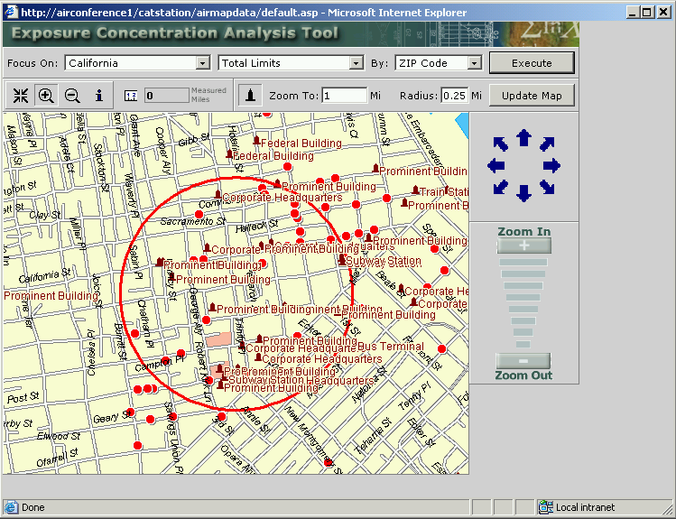
Proximity to Terrorist Targets - Ring Analysis

Slide 22
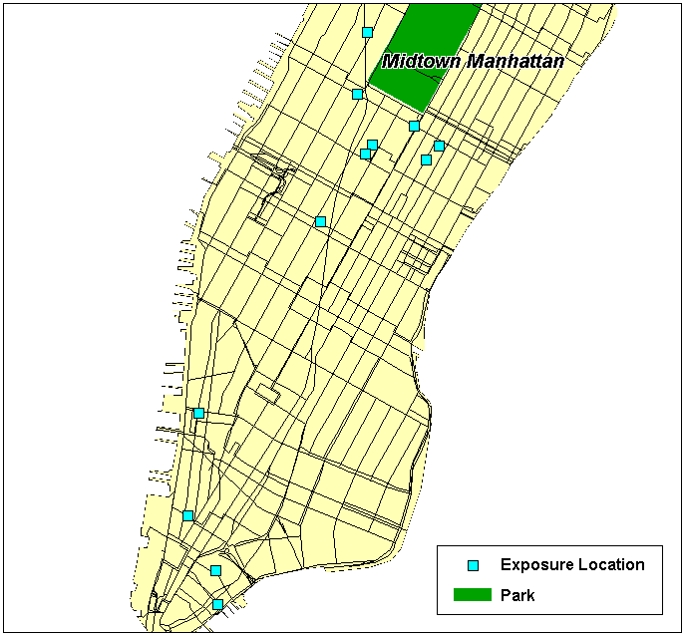
Sample Exposure Portfolio

Slide 23
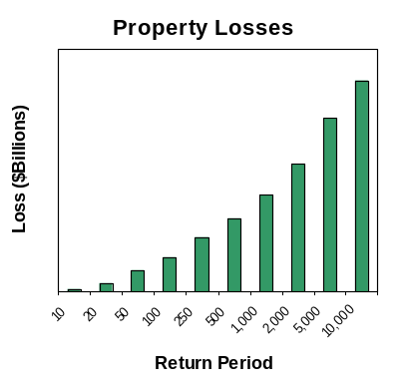
Exceedance Probability Curve Results for Portfolios

Slide 24
Uses of AIR Terrorism Model Results
Manage terrorism exposure
  Understand exposure concentrations relative to potential terrorism targets
  Help price terrorism coverage down to location-specific levels
  Establish underwriting guidelines to offer profitable coverage while controlling risk
Determine effects of the Terrorism Risk Insurance Act of 2002
Quantify capital and reinsurance needs
Provide basis for ISO loss costs

Slide 25
Model Results Confirm What We Know
Major cities have been identified as favored targets, particularly for conventional weapons attacks
  National symbols of government and capitalism
  Vital economic centers and embassies
  Places of amusement
  Critical infrastructure
  Mass casualties objective
Major urban areas offer freedom of relatively unhindered operations
  Surveillance of targets, meetings, movement
  Public street access to exterior of many buildings
Higher loss per event due to urban density
  Vertical exposure versus horizontal footprint
  Landmarks surrounded by dense commercial property, not parking lots
Higher replacement cost per square foot

Slide 26
Similar Experience With Other Perils
Earthquake premiums are predominantly a California burden
  California average annual loss is 72% of U.S. total
  Total U.S. average annual earthquake loss is much greater than U.S. terrorism property loss estimates
Hurricane loss cost relationships also show variations similar to terrorism
  Florida is approximately 50% of U.S. total
  Florida average annual hurricane loss estimates are greater than entire U.S. terrorism property loss estimates
  Florida statewide is more than 10 times higher than New York state
  Miami Beach is over 100 times higher than Washington, D.C.
  After Hurricane Andrew homeowner premiums in Florida increased substantially

Slide 27
Use of AIR Models in ISO Advisory Loss Costs
Industry-wide analysis
  Commercial property
  AIR industry exposure database
  Average annual loss
  Separate building and contents results
Modeled certified acts
Gross industry loss was adjusted for other factors
  Contingent BI
  Other commercial lines
  Alternative markets
  Loss adjustment expenses
  Federal backstop

Slide 28
Terrorism Risk Insurance Act of 2002 Issues
State approval processes for rates and forms
Non-certified events
Significant change each year -- sunset in 2006
Combined commercial business lines
No “occurrence” concept - based on annual aggregate
Not a pool - each company is on its own
No coverage for reinsurer losses
Existing policy exclusions remain
Profile of potential loss characteristics
Pricing and the market to date

Slide 29
For Further Information, Please Contact
Jack Seaquist
AIR Worldwide
617-267-6645
jseaquist@air-worldwide.com
THANK YOU

